Slide 1
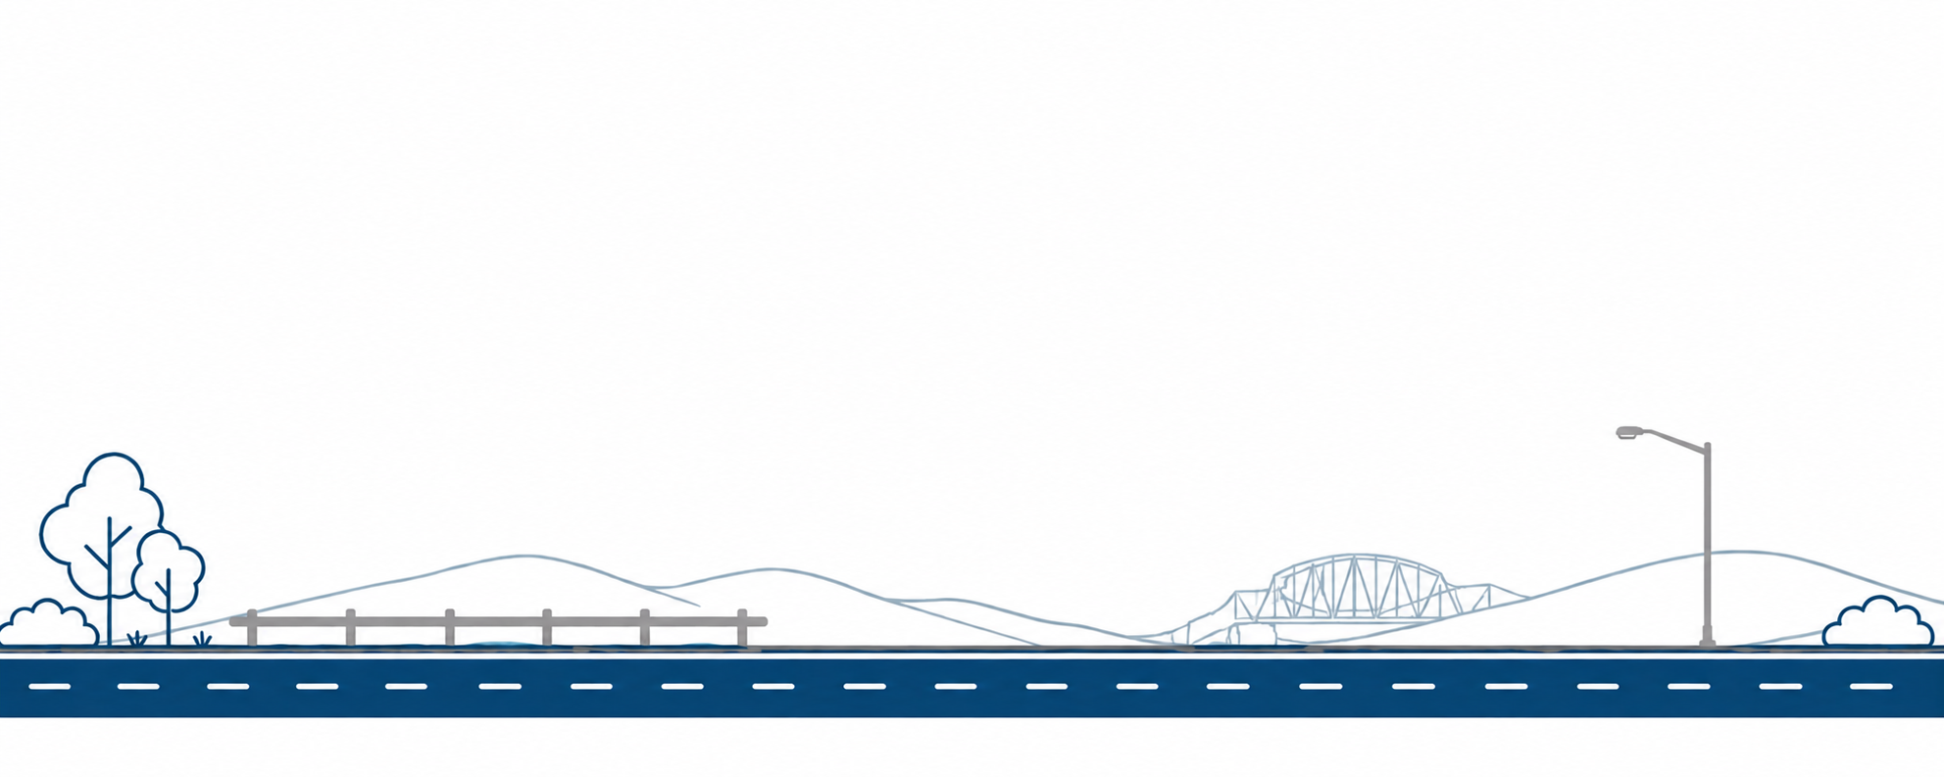


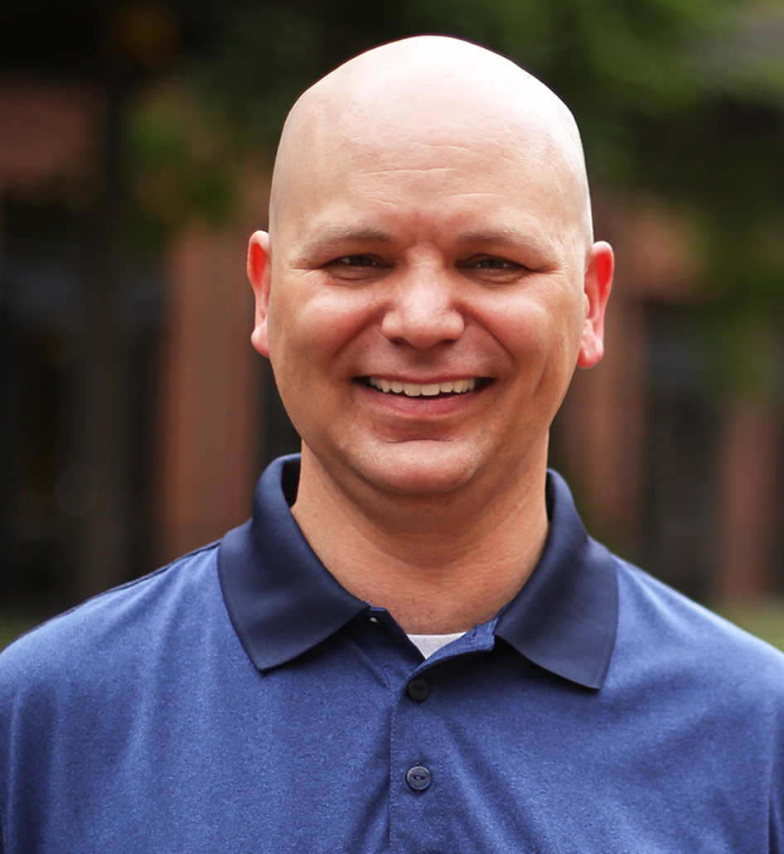
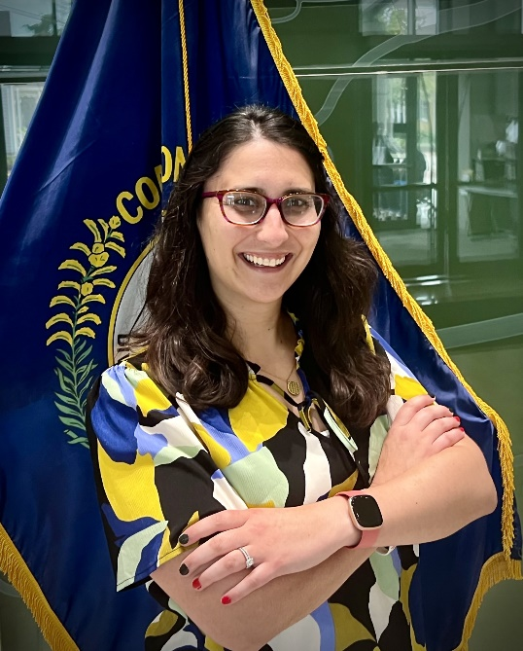



STANDARDS IN MOTION:
UPDATES FOR STANDARD DRAWINGS
Jeff Jasper, PE
KTC
Research Engineer
Corinne (Cory) Schurman, PE
KYTC
Transportation Engineer II
Thursday, September 10th
8:00-8:50am &
1:00-1:40pm

Slide 2


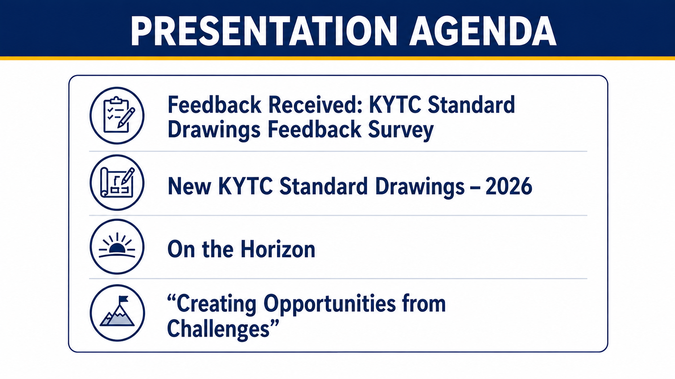

Slide 3


Slide 4


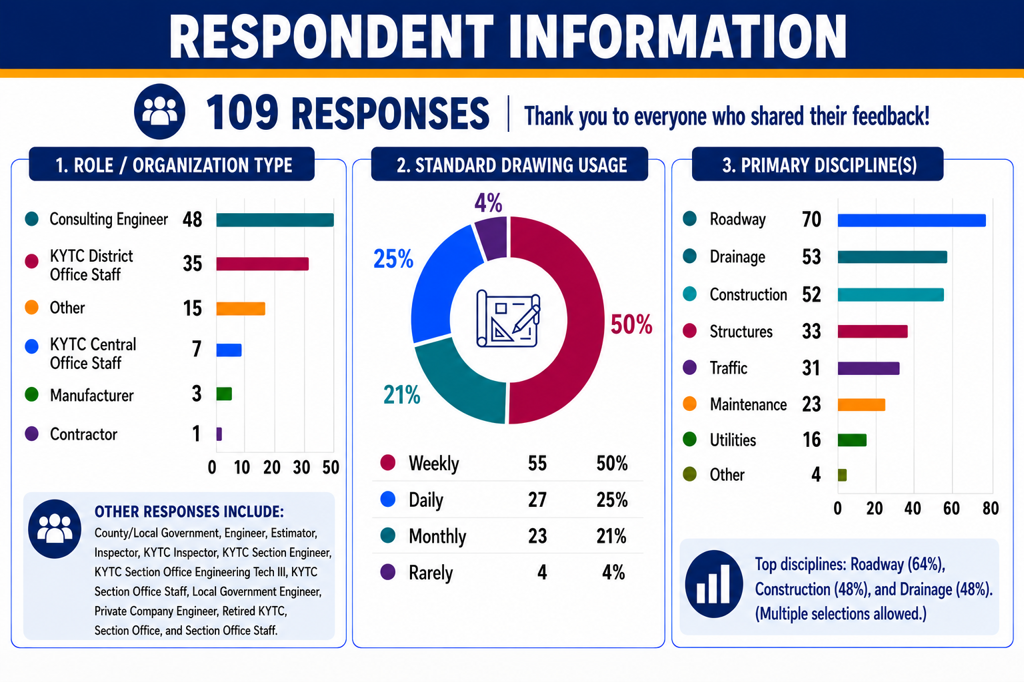
Notes:
Brief summary of the survey: Avenues for distribution included directly on the standard drawing website; Listserv; Contractors’ Association; Construction; ACEC; Maintenance.
50/50 consultant and private industry
Half and quarterly percentage
Roadway, drainage, and construction
Overall key: pleased with variety

Slide 5
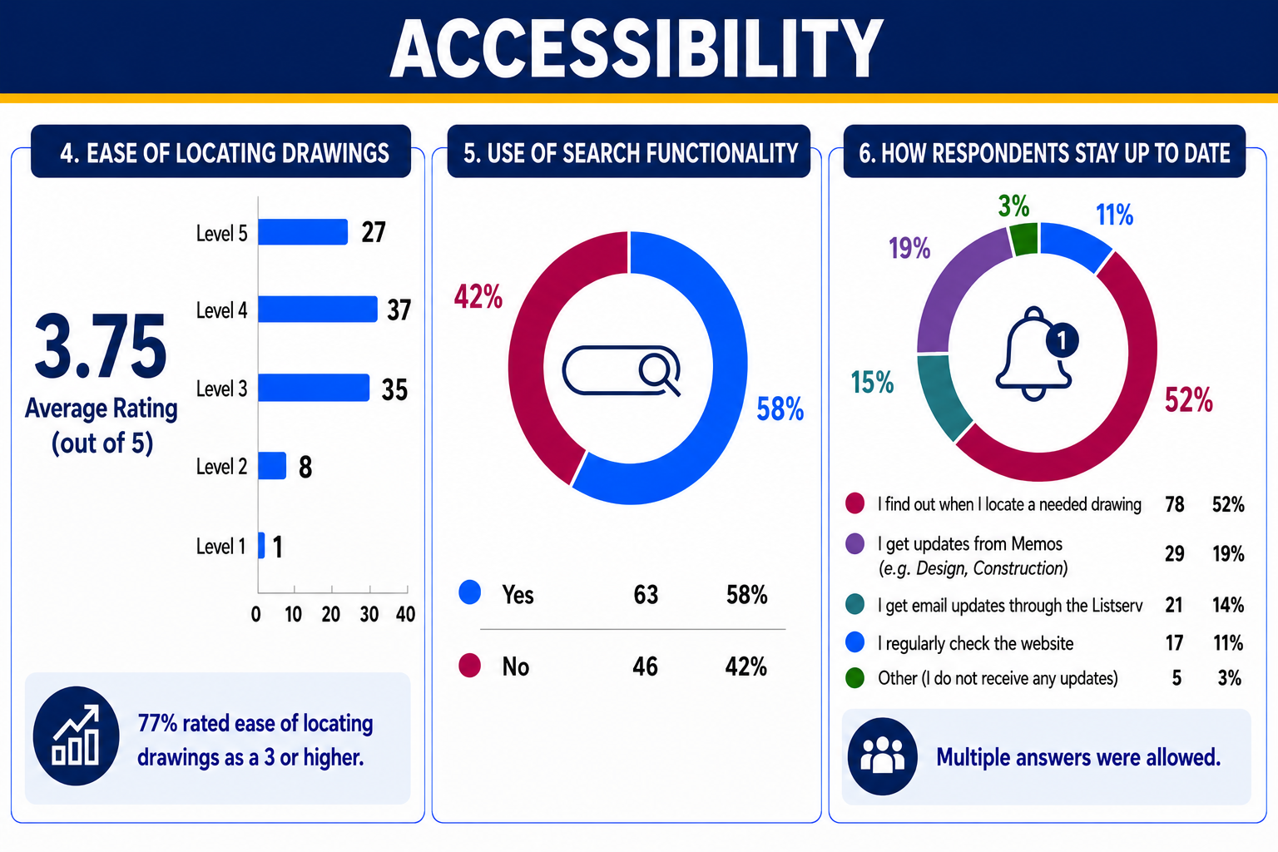
Notes:
4. Good, of course we would want it to be higher. Goal would be locating easier.
5. Adopted a handful of years ago. Goal: getting folks familiar with. Among people who rated finding drawings 3/5 or below, nearly half (49%) do not use the search function at all. Meanwhile, among those rating the website 4–5/5, 38% still don't use Search. Opportunity: Increase awareness of Search functionality and how to use it effectively.
6. Blurb about more than 109 on purpose since more than one. Mention the Listserv—especially for communication for drawings that are archived, renamed, combined, new guidelines, etc.

Slide 6
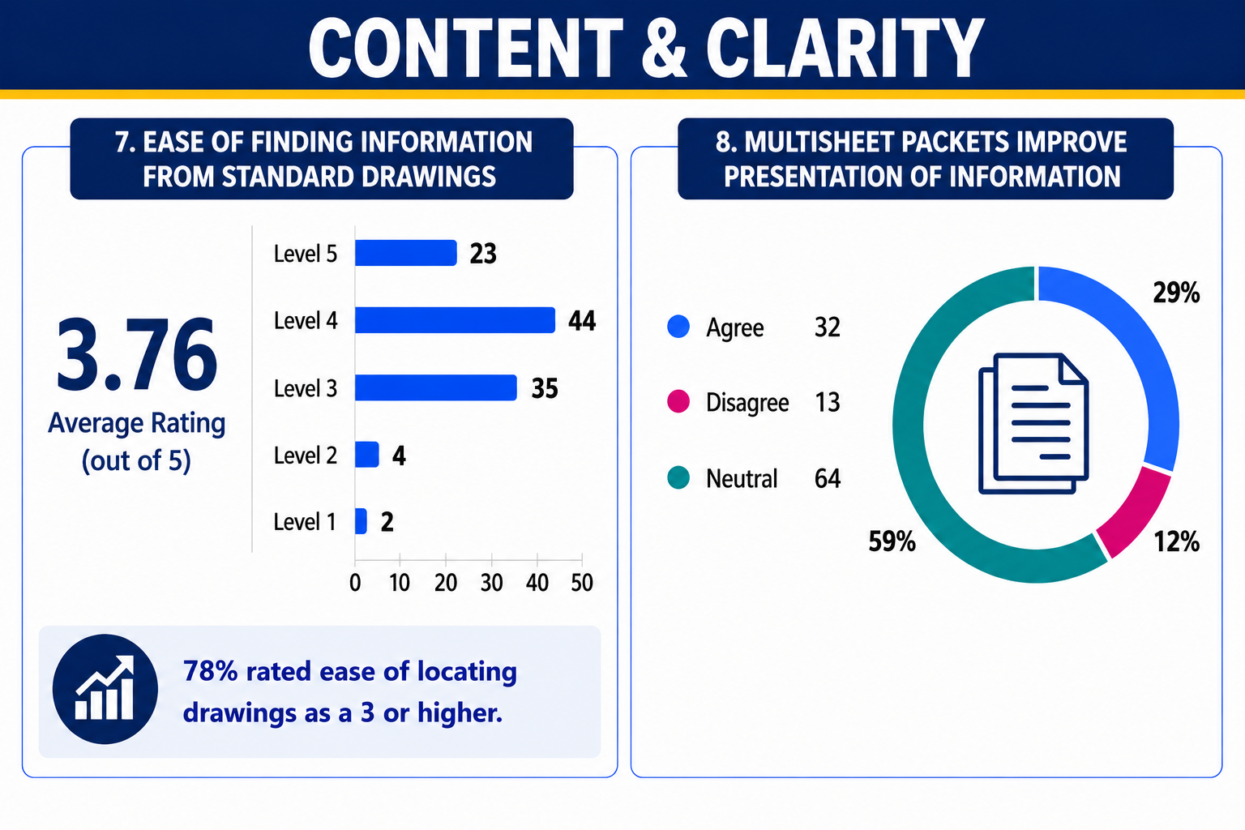
Notes:
7. Good average, but we would want it to be higher
8. Of the 23 respondents who rated the ease of finding information on a particular drawing a 5/5, 56% agreed that the packets improved information presented. For the respondents who rated the ease a 3 or lower, 86% rated the improvement with packets either neutral or disagree.

Slide 7
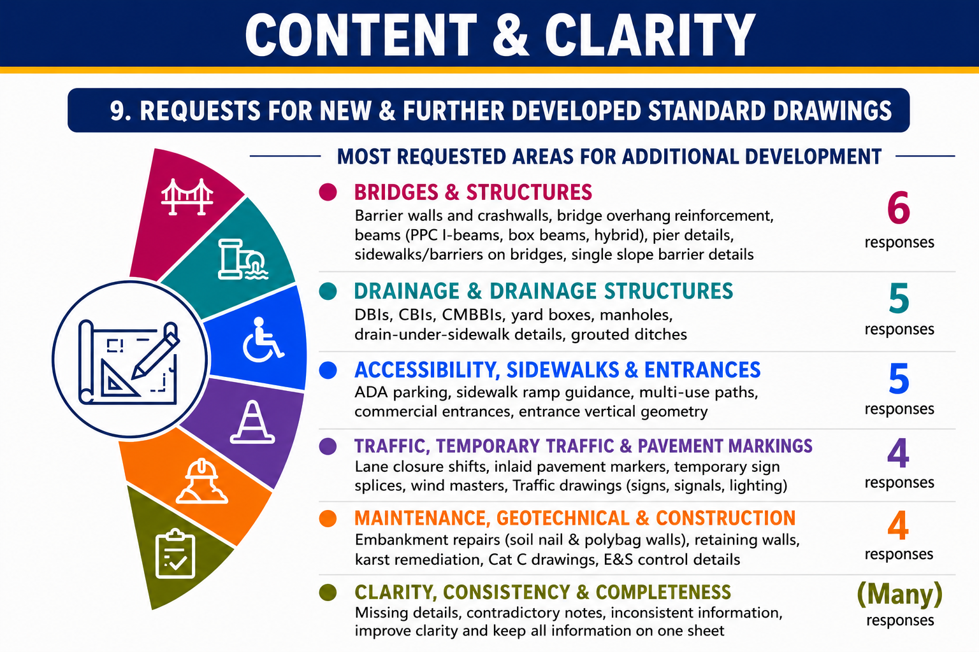
Notes:
Received lots of great feedback on new or needing further development. We understand we have lots of areas to improve and work ahead of us. If you haven’t had a chance to let us know about any improvements you’d like to see, feel free to let us know. Come talk to us or send us an email. We understand some requests have been asked for over quite some time and we continue to prioritize and work through them all.

Slide 8
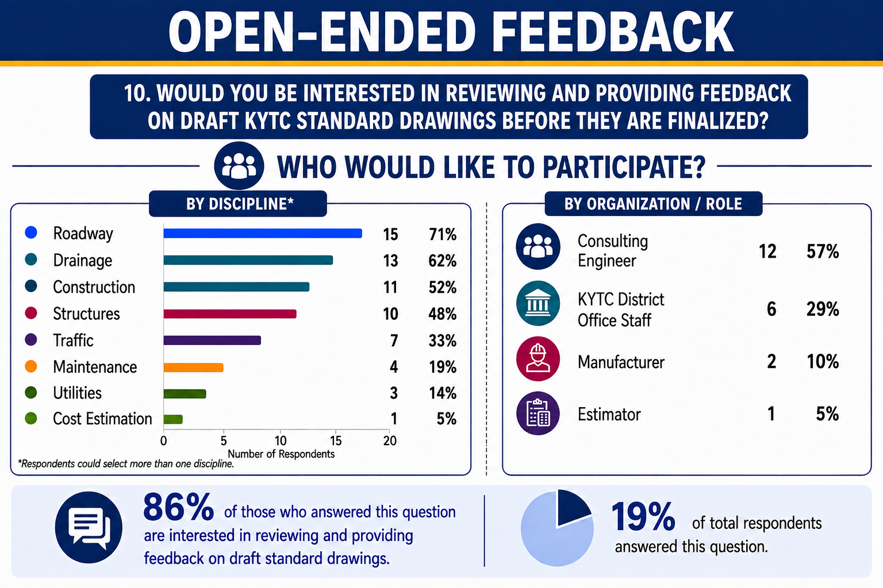
Notes:
Question ten focused on adding to our review team.
Remind the group: we have a team of people to review drawings prior to finalization.
Focus on how we want the diversity in this review team and we welcome participants.
From this poll, we will bring on new team members from public and private.

Slide 9
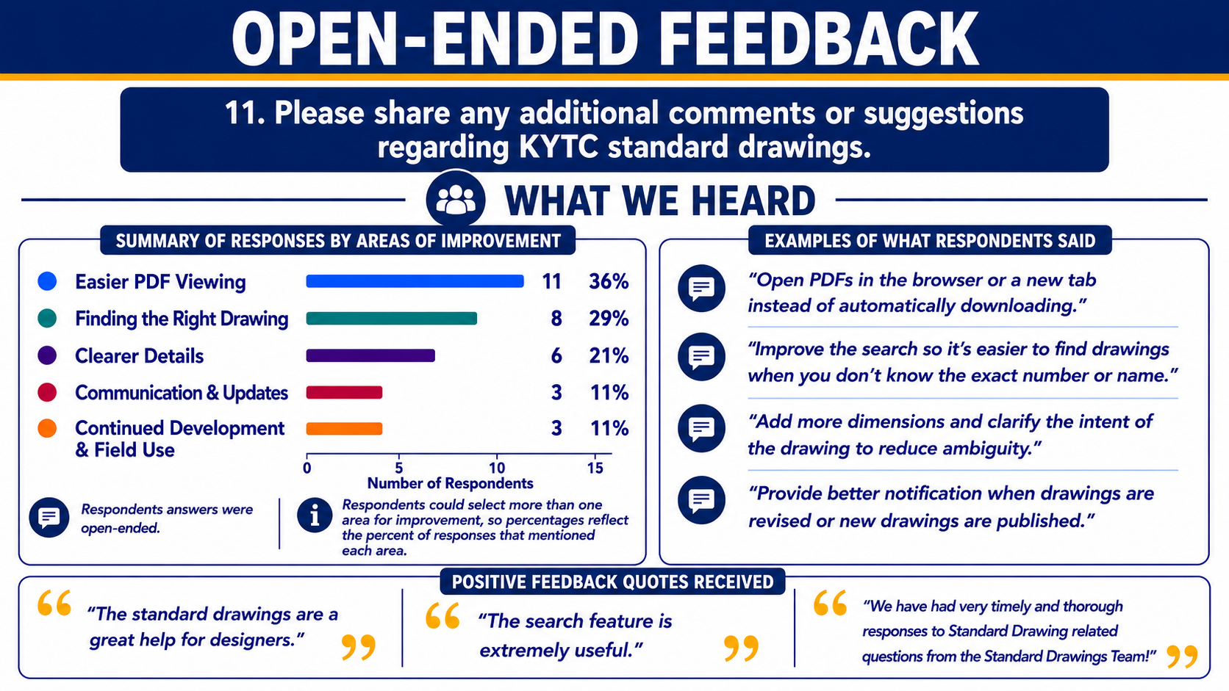
Notes:
Talking about standard drawings as whole versus specific details on the drawings themselves.
Could read a handful of the quotes, like how the one mentions our whole team.

Slide 10
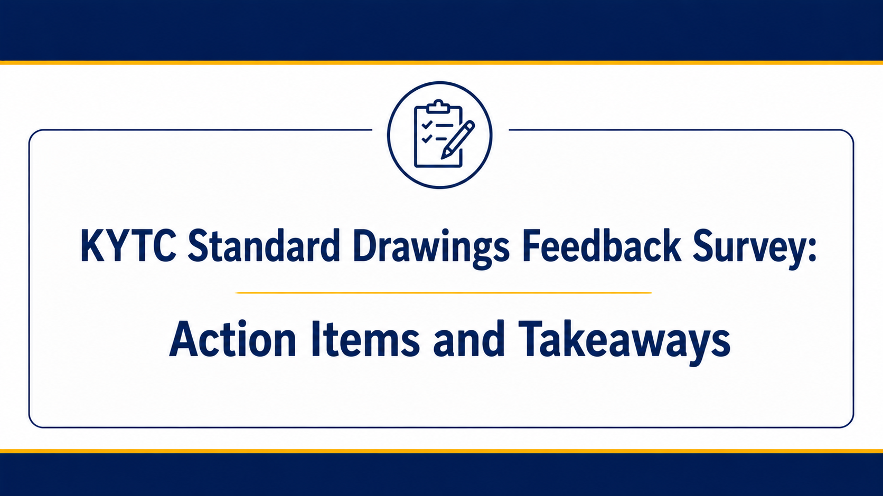

Slide 11
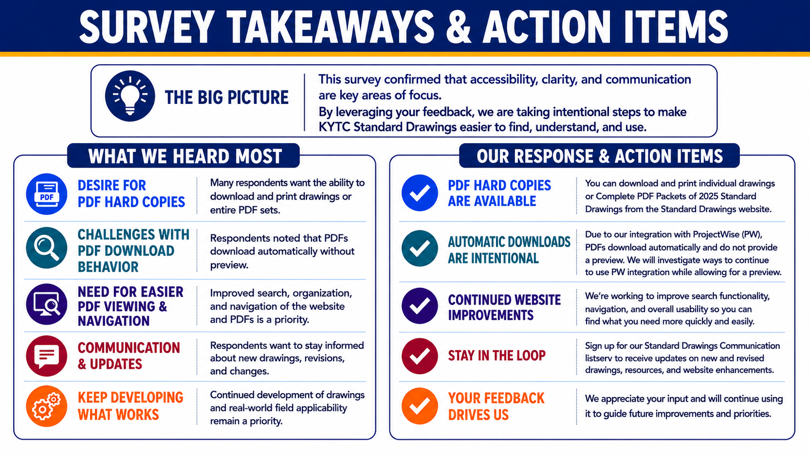
Notes:
Use this slide to address each item and let them be aware of capabilities. This is why we did the survey and drive that point home.

Slide 12
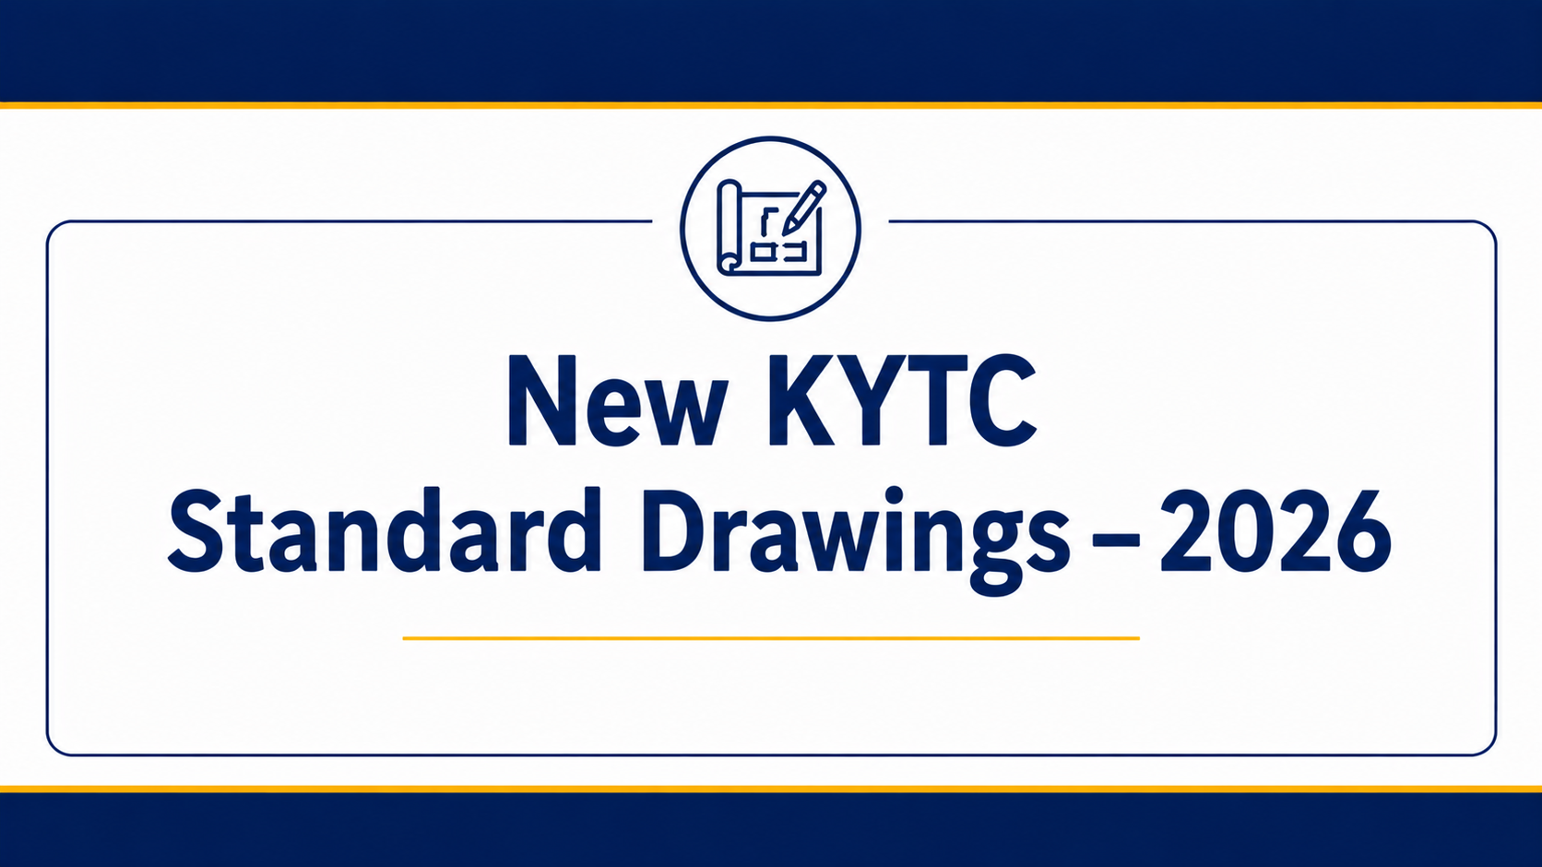

Slide 13
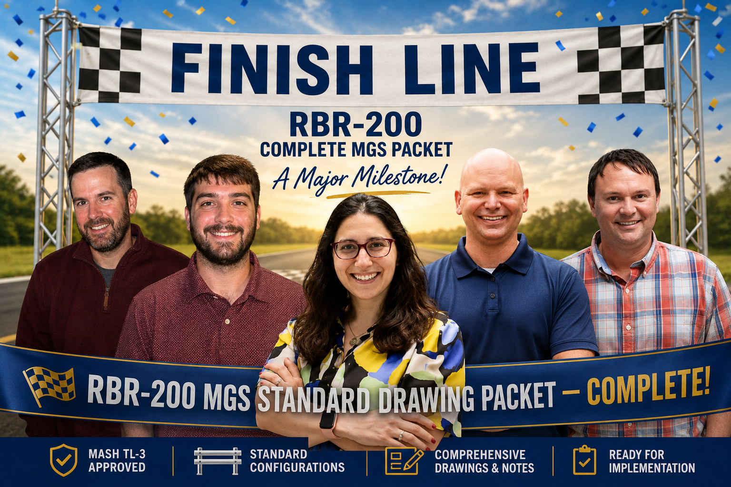

KYTC Standard Drawings

Slide 14
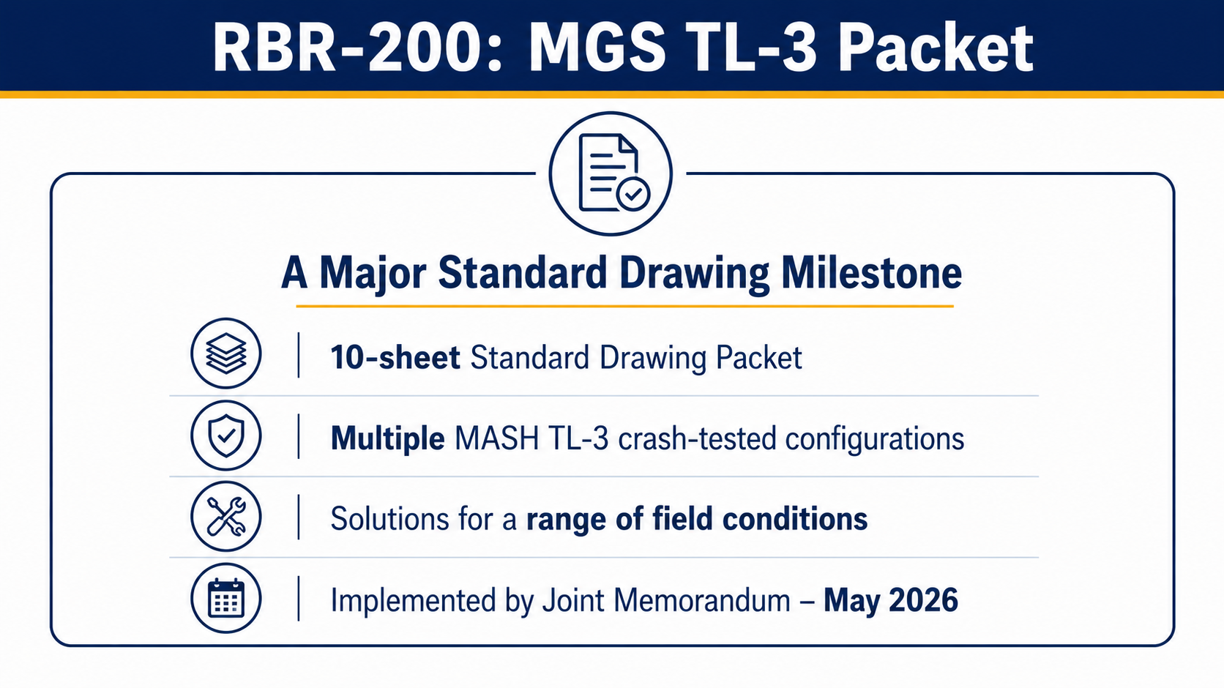
Notes:
The packet gives designers a toolbox of crash-tested MGS configurations for different real-world conditions.
The packet brings several MGS configurations together that were not previously available in KYTC Standard Drawings:
Standard MGS configuration
Guardrail stiffening using reduced post spacing
Slope-hinge / limited shoulder-width installations, including 6-ft and 8-ft posts
Double-faced MGS
Omitted-post configurations
Long-span configurations for two or three omitted posts

Slide 15
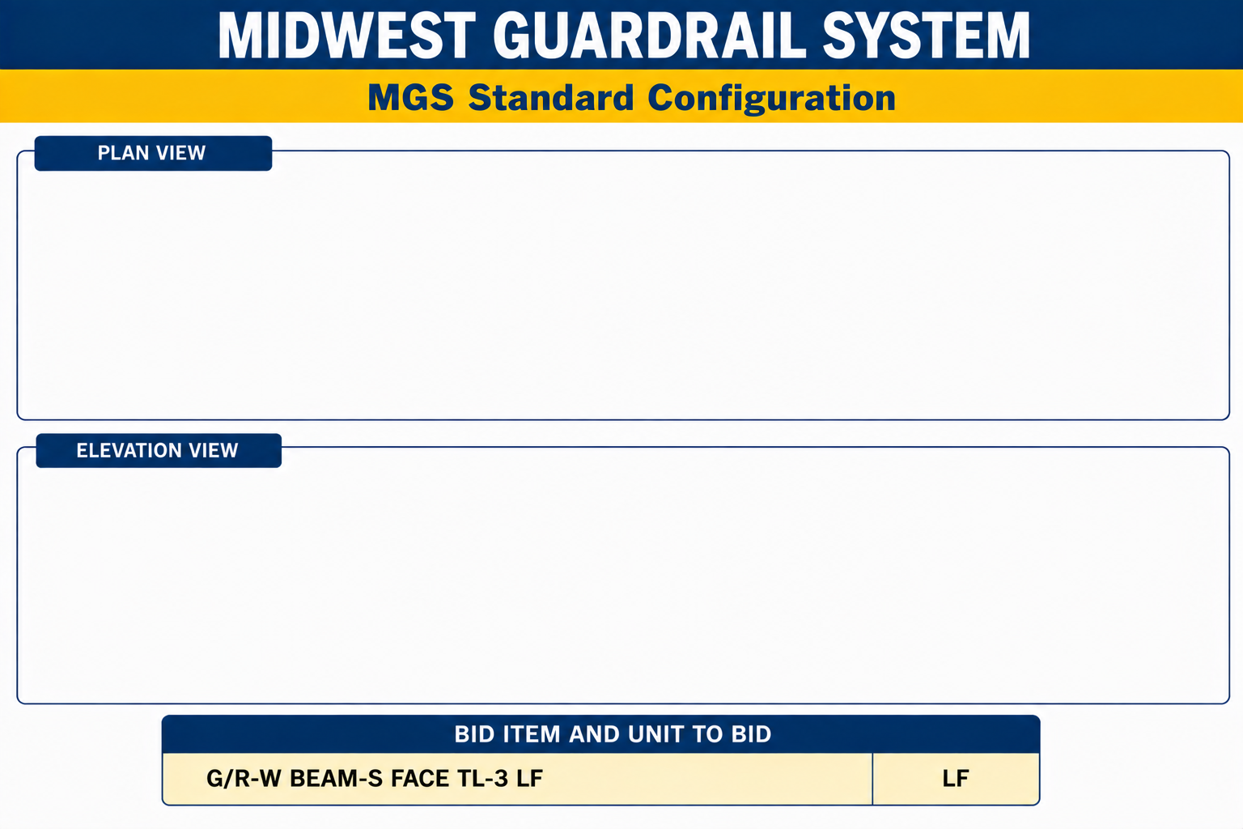
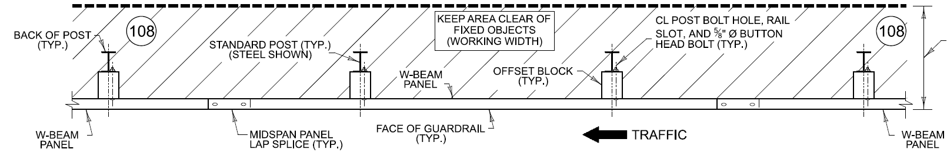

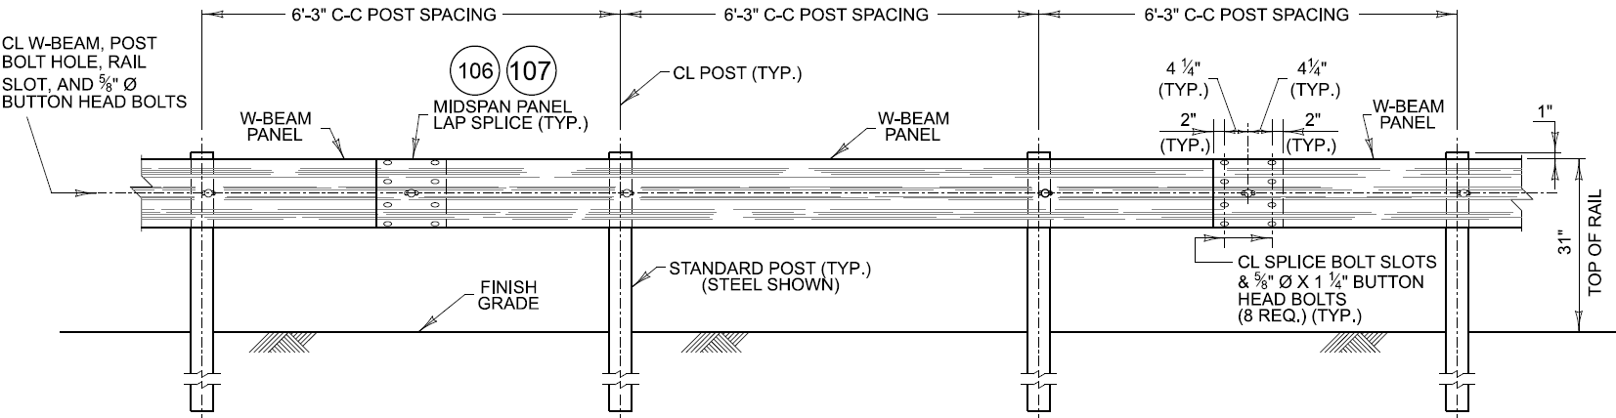

Slide 16
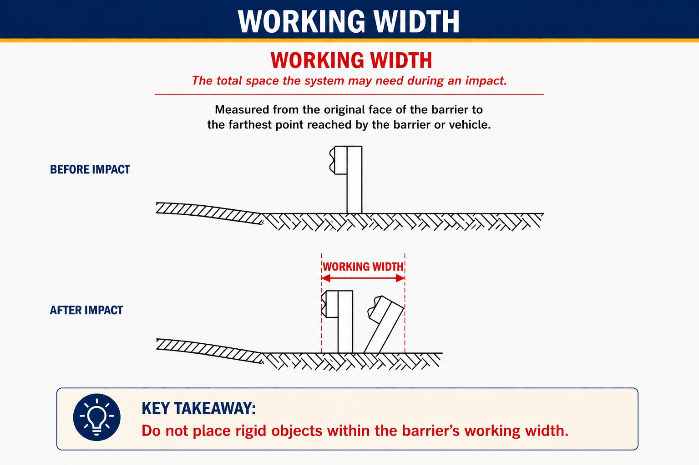

Slide 17
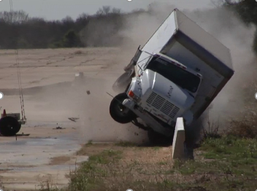
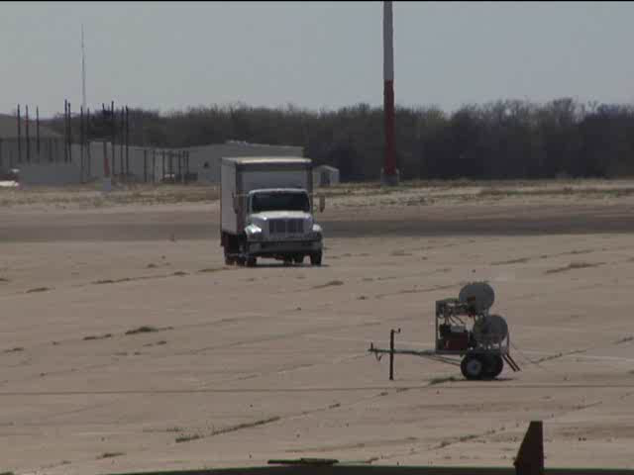
Zone of Intrusion
Working Width

Slide 18
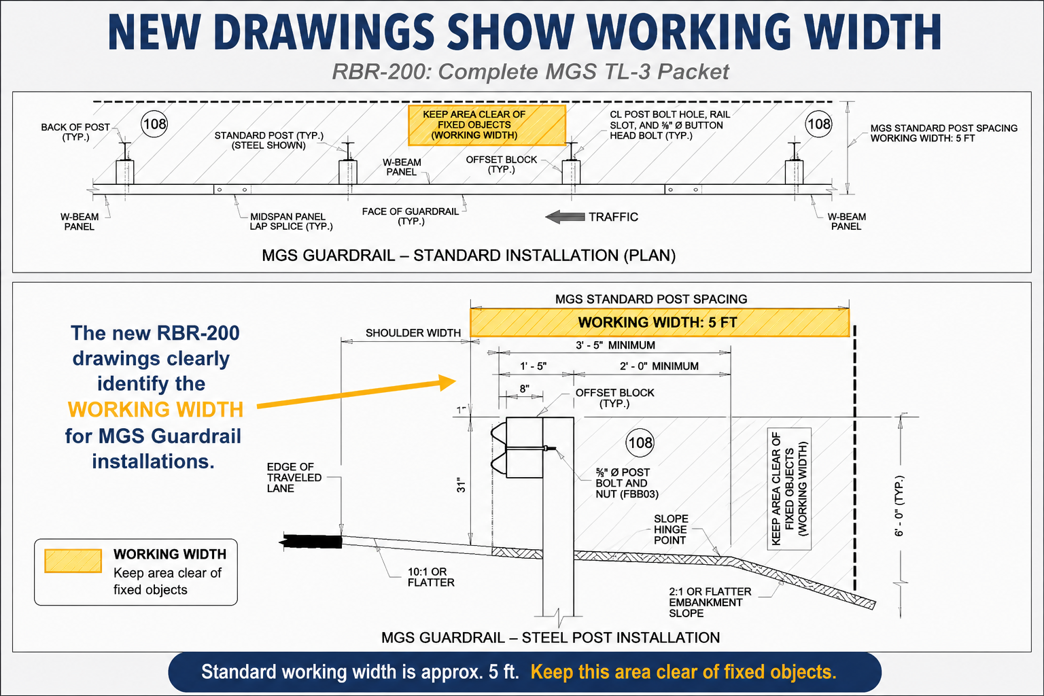
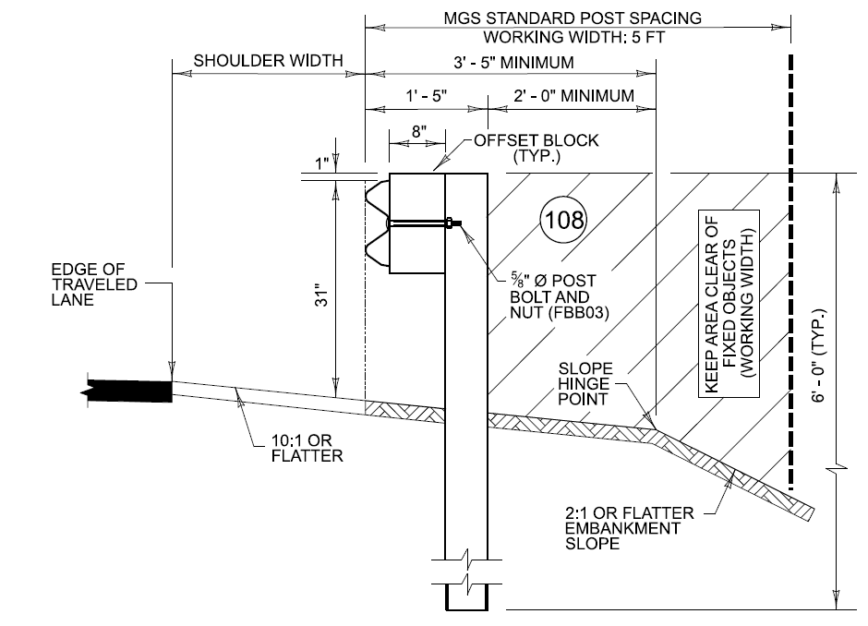

Slide 19
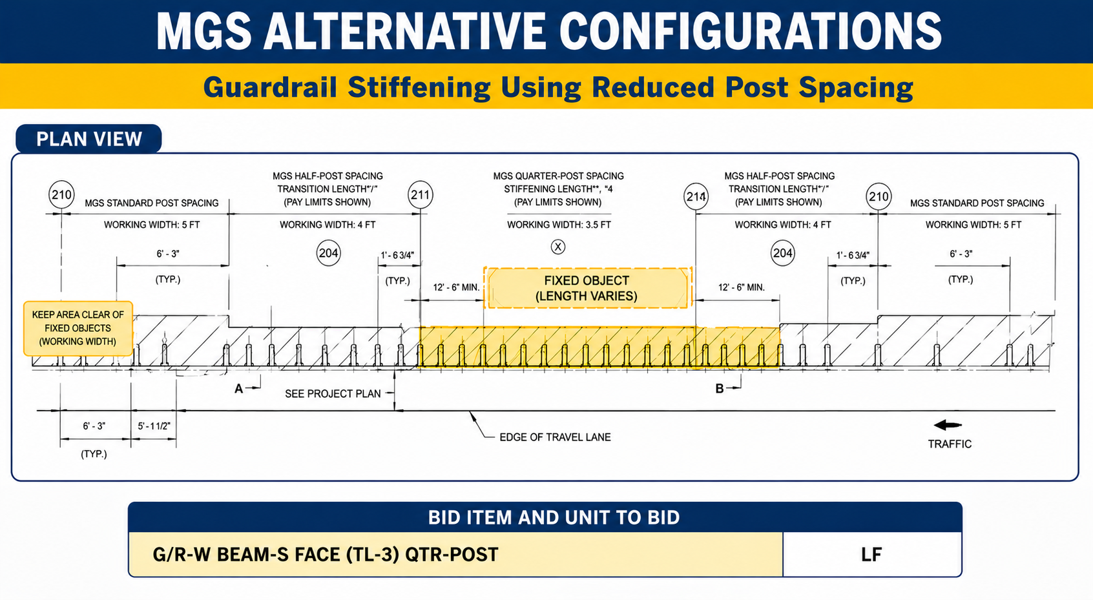
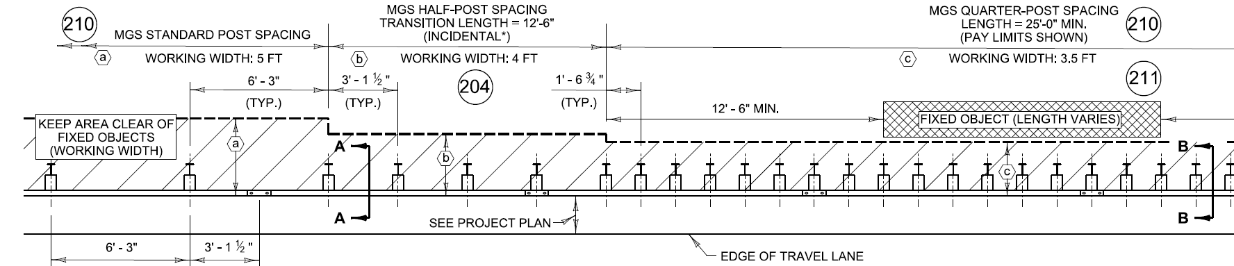


Slide 20
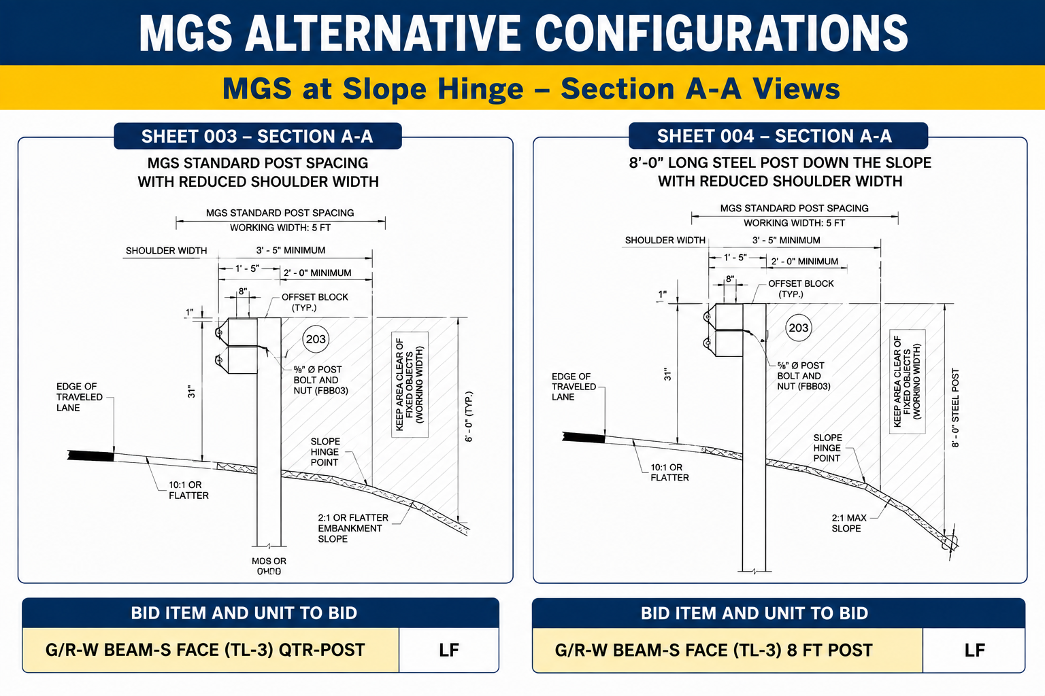
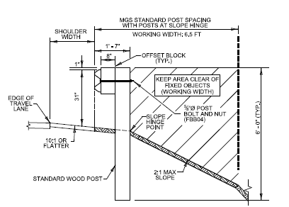
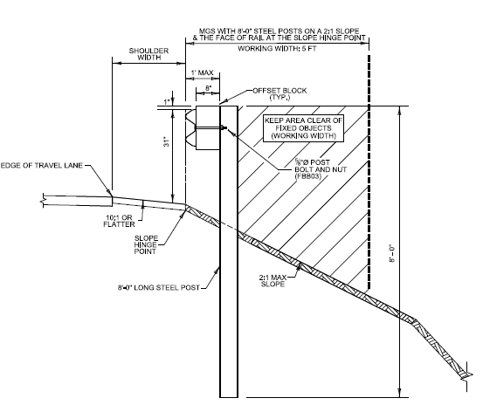
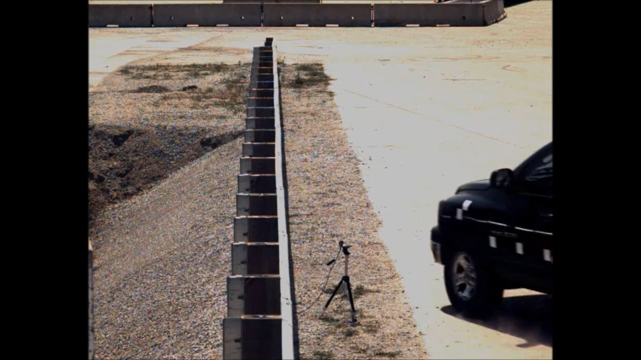

Slide 21
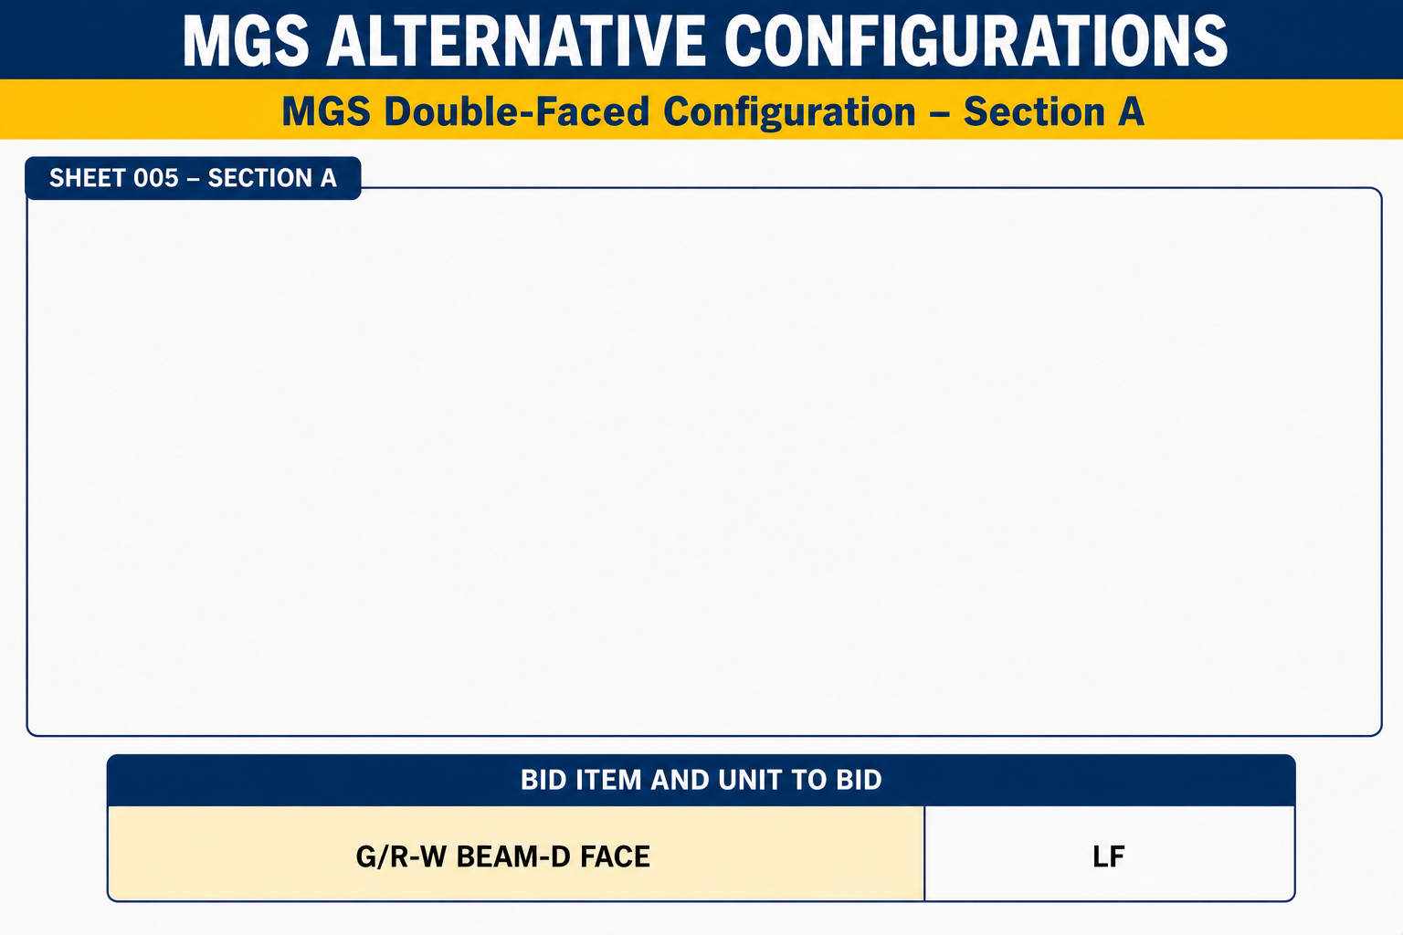
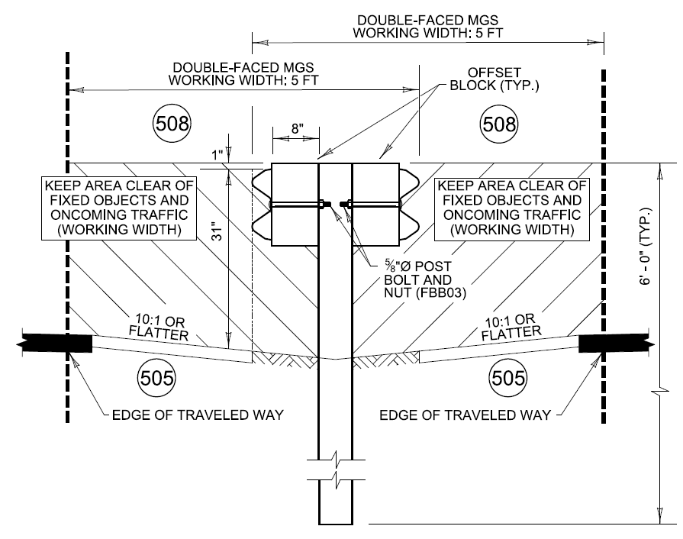

Slide 22
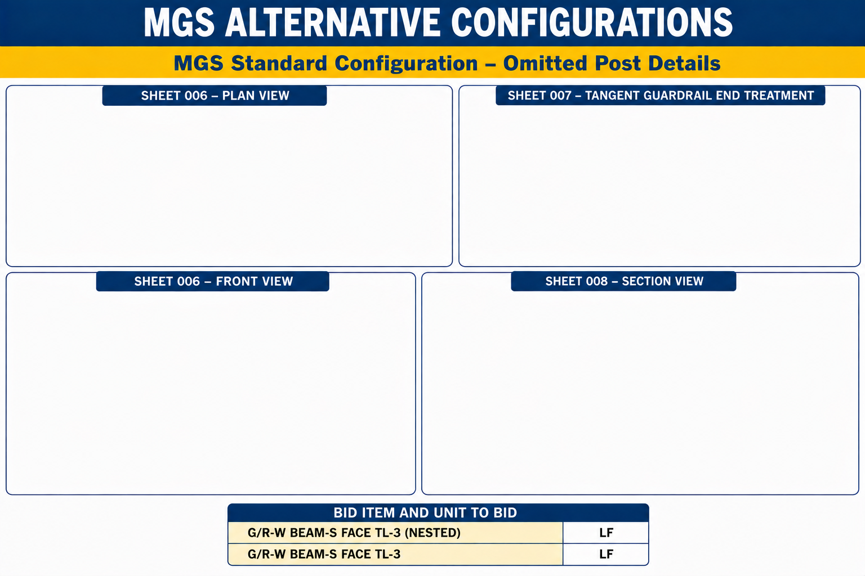
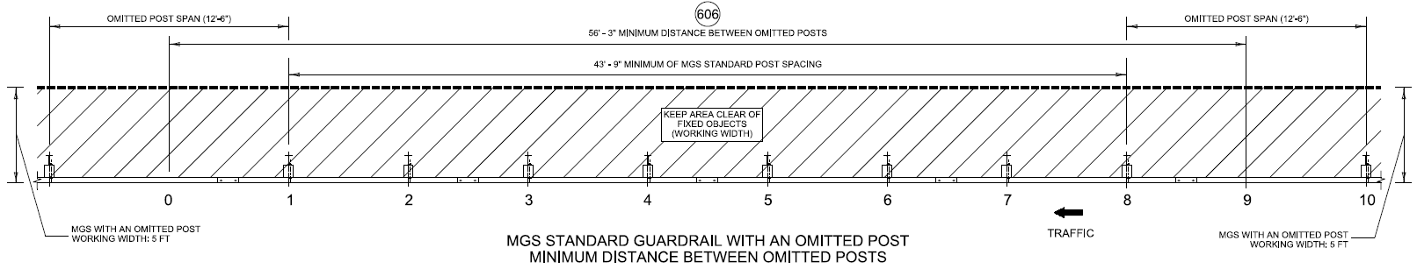
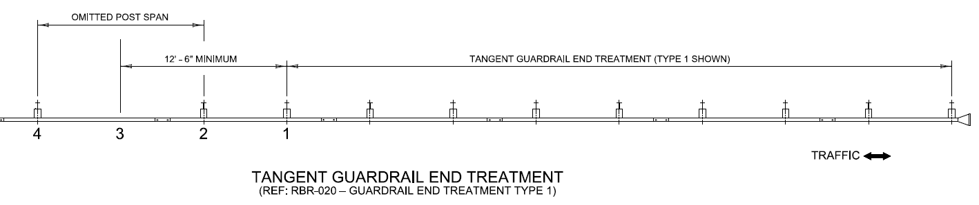
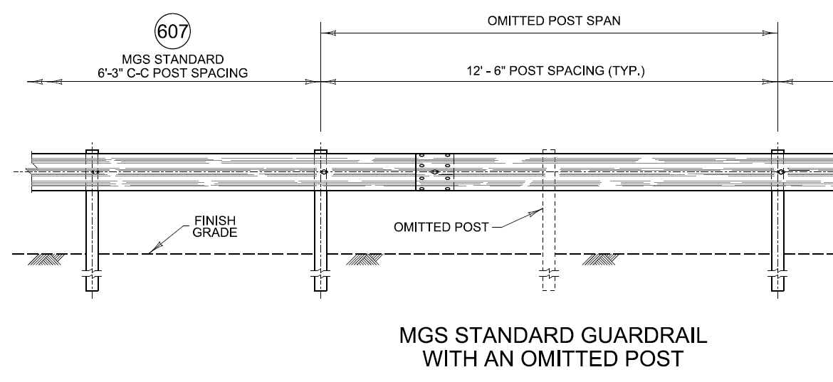
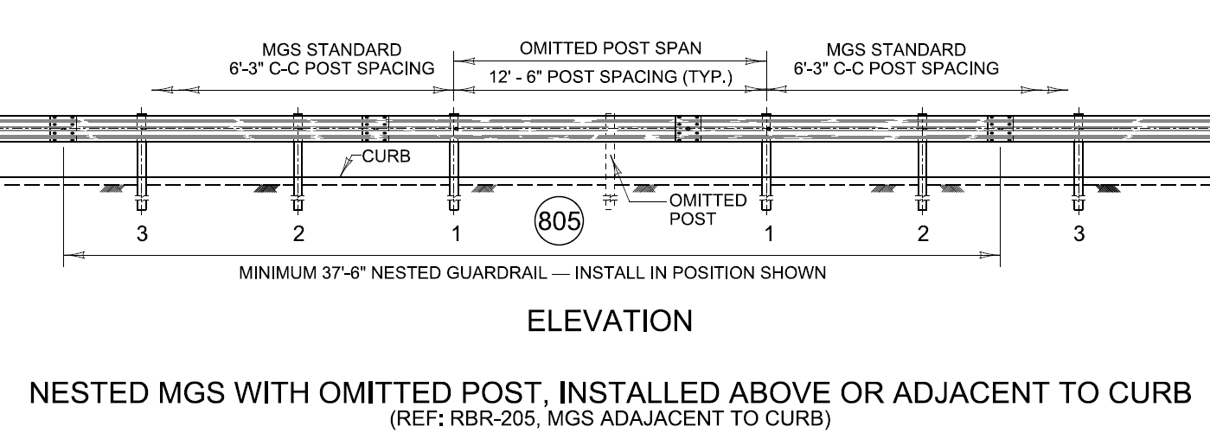
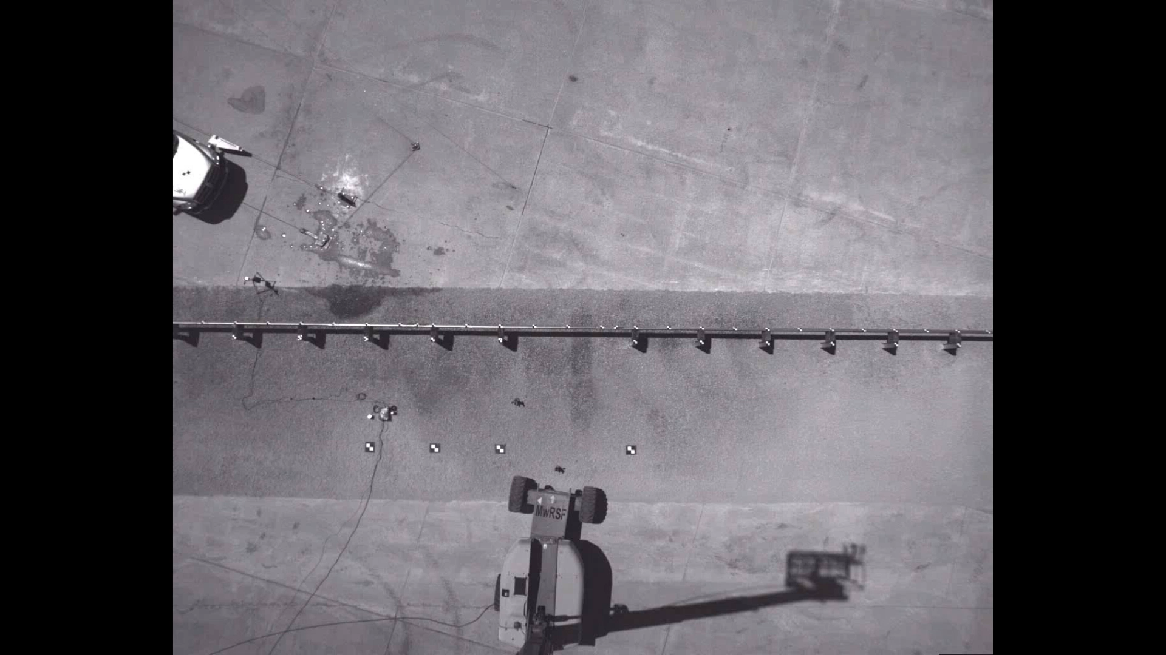
Notes:
Note: Additional drawings are included showing minimum distances from end treatments, etc.

Slide 23
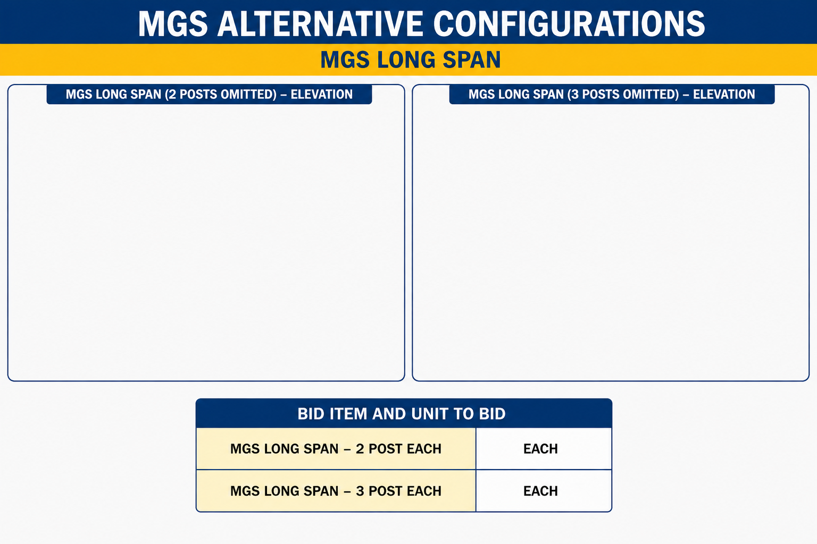
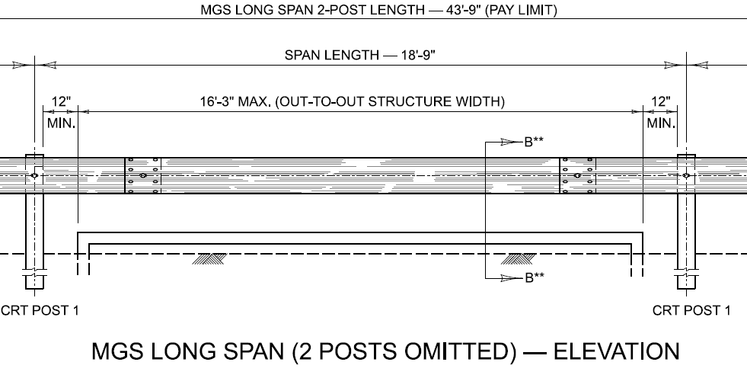
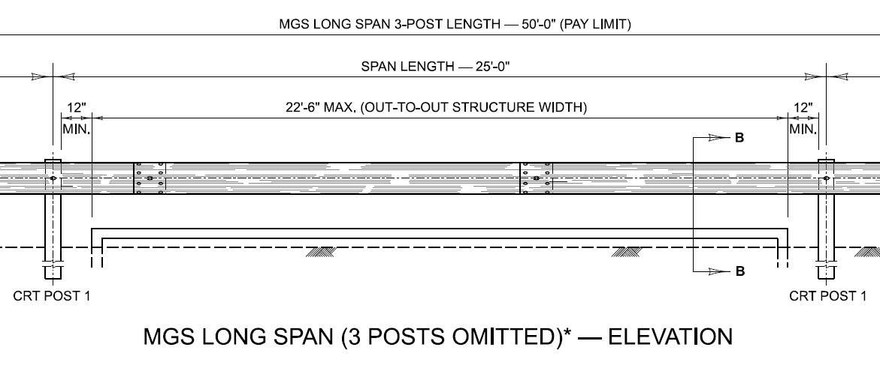
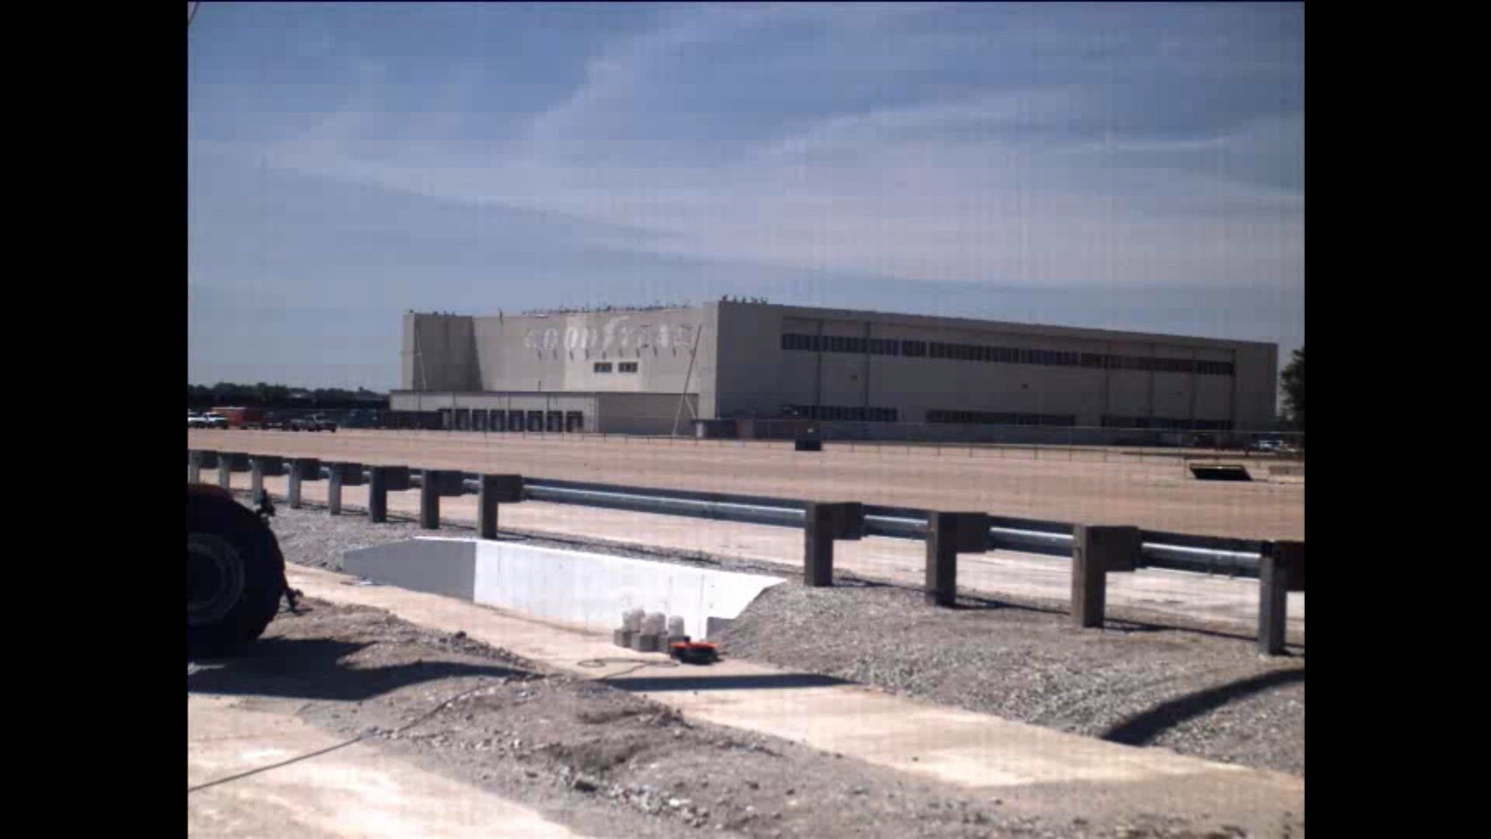

Slide 24


Slide 25
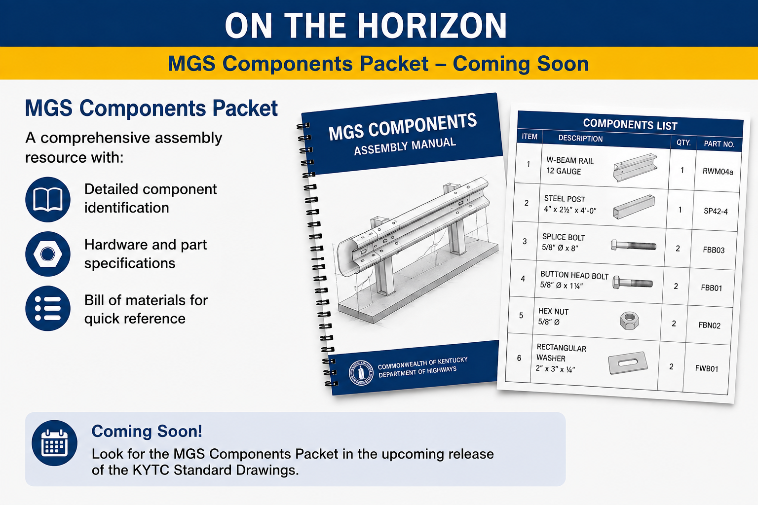

Slide 26
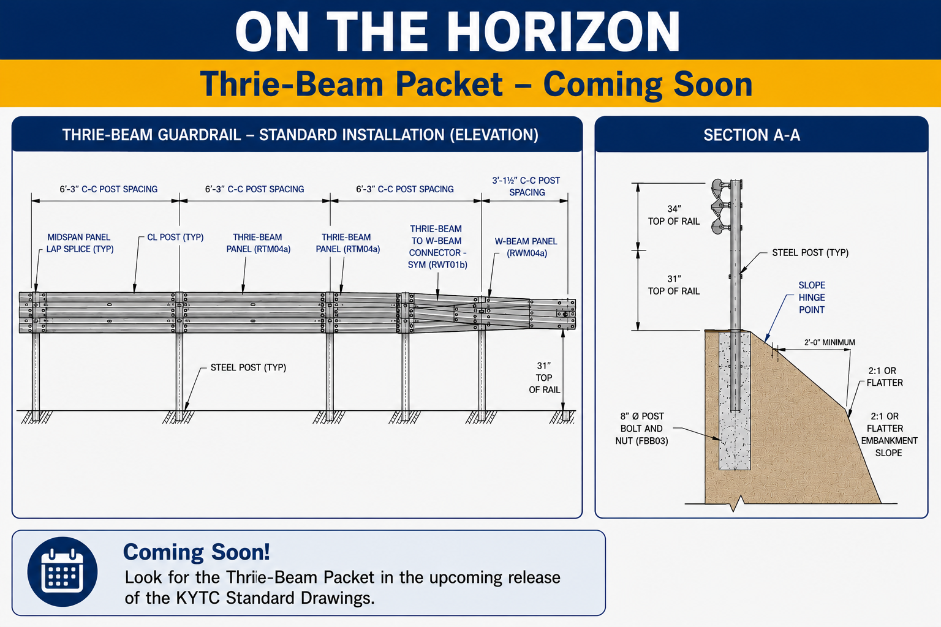
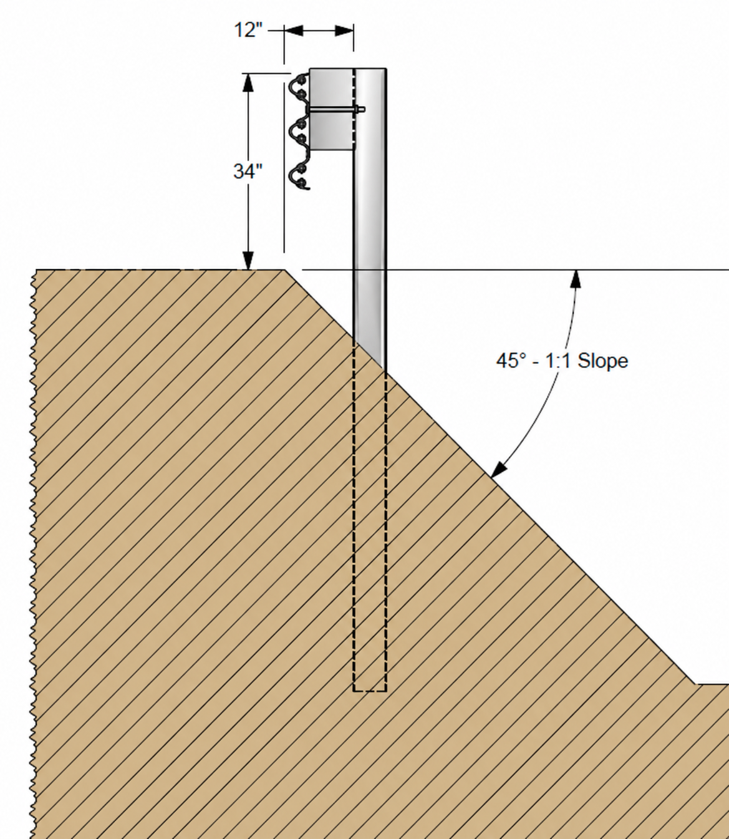
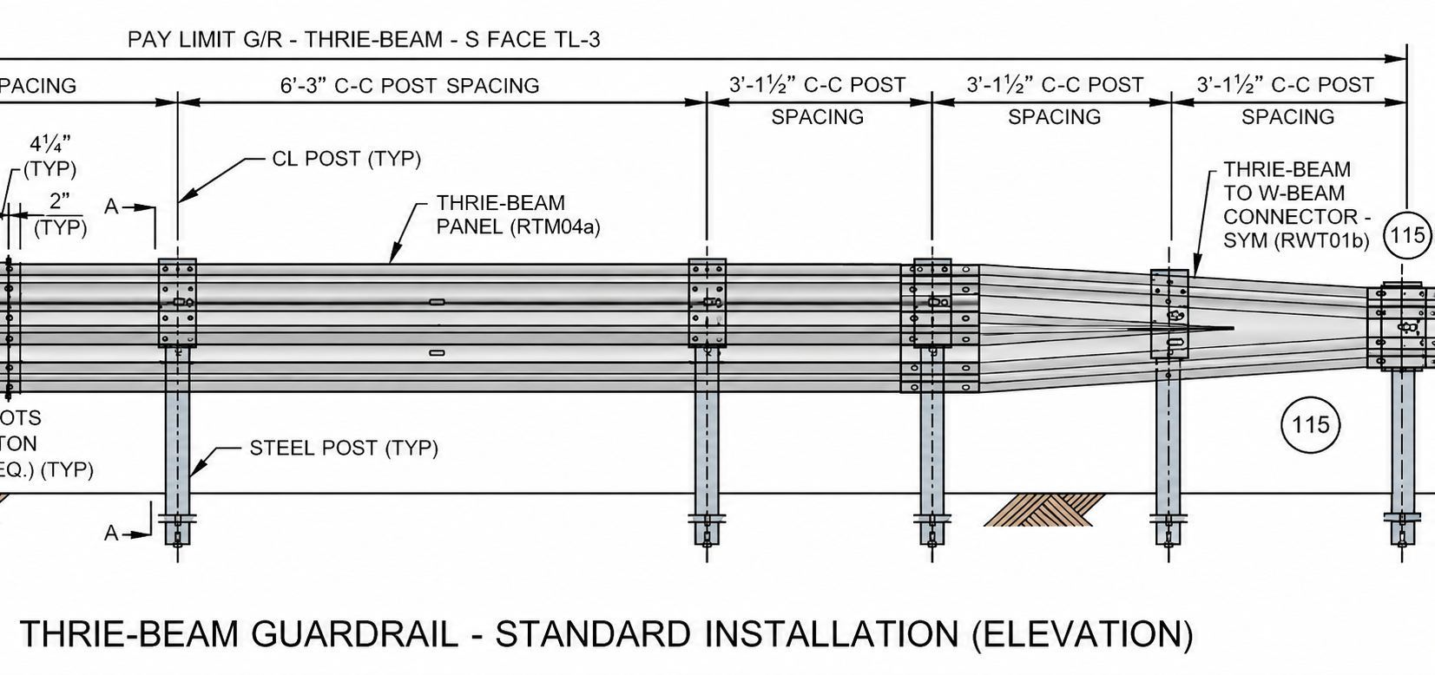

Slide 27
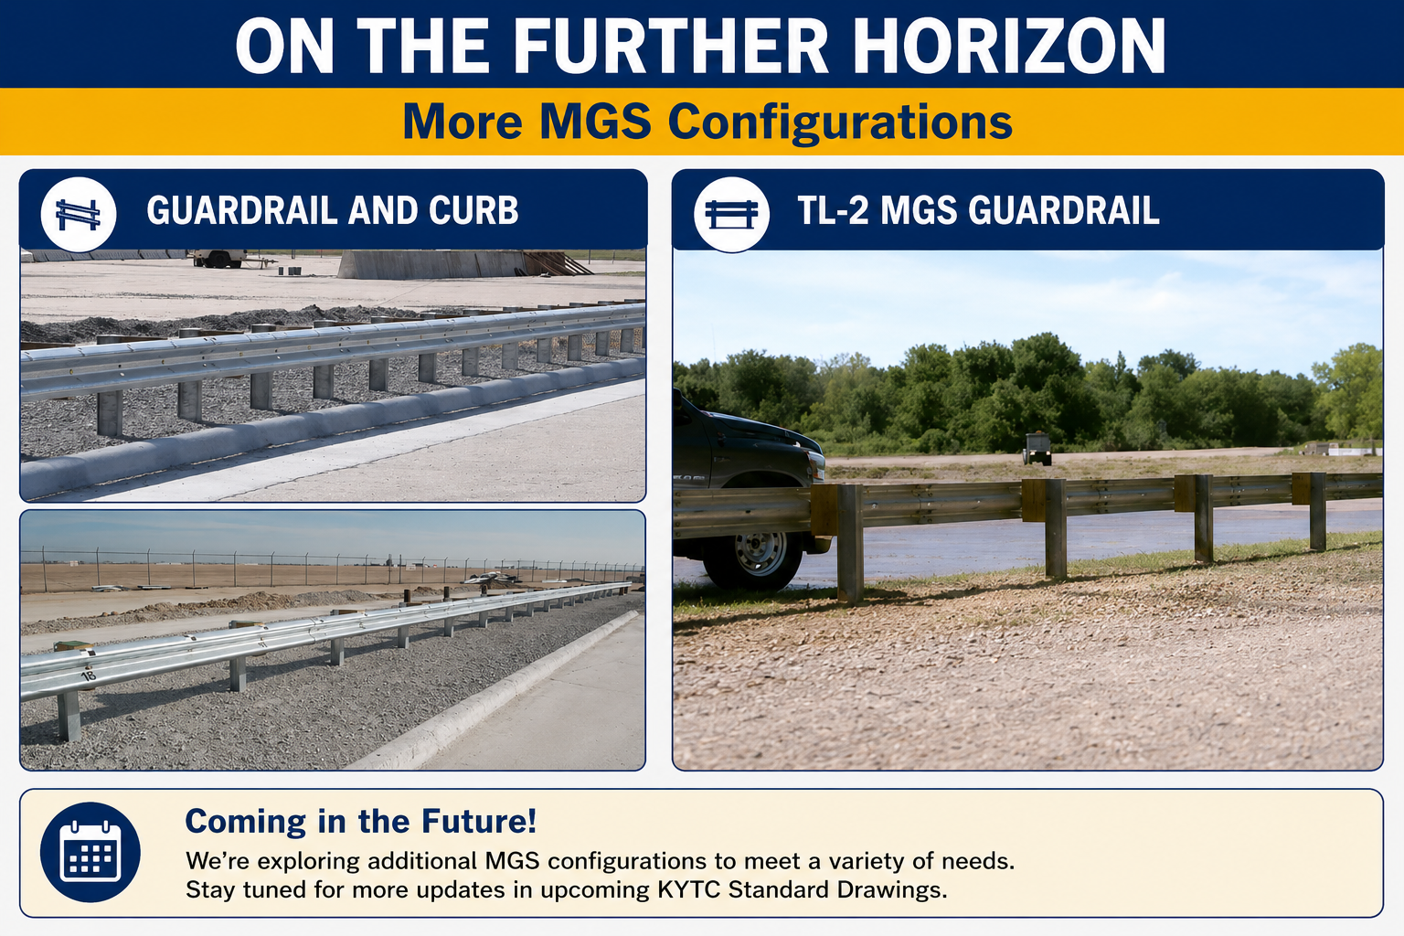

Slide 28

Notes:
Overall, the purpose of regular updates, MASH tested configurations, and team collaborations are all efforts to give designers and those in the field more opportunities. We understand there are challenges in adapting to these changes. And overall challenges with adapting to industry changes. Standard Drawings creates opportunities to resolve the challenges.

Slide 29
Thank you for attending our session on
STANDARDS IN MOTION:
UPDATES FOR STANDARD DRAWINGS
Corinne Schurman, PE
Corinne.Schurman@ky.gov
Jeff Jasper, PE
Jeff.Jasper@uky.edu
Questions?

